Slide 1
Respiratory System

Slide 2
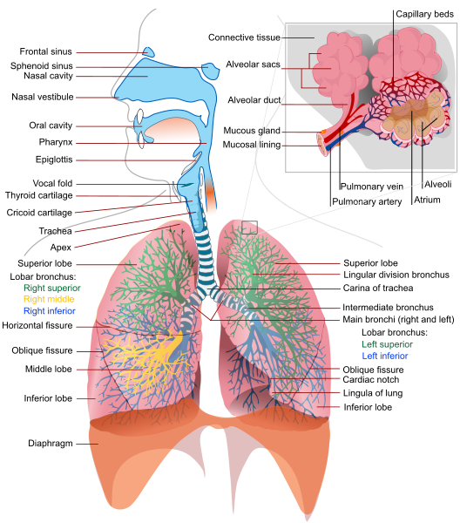
Respiratory System
Notes:
http://commons.wikimedia.org/wiki/File:Respiratory_system_complete_en.svg

Slide 3
Respiratory System
What are some of the organs that make up our respiratory system?

Slide 4
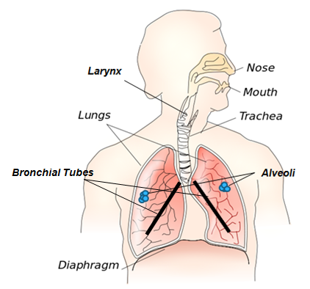
Respiratory System
Organs include:
larynx (voice box)
trachea (wind pipe)
bronchial tubes
lungs
alveoli
diaphragm
Notes:
http://commons.wikimedia.org/wiki/File:Respiratory_system.svg

Slide 5
Respiratory System
Air travels from the mouth or nose through your larynx (voice box), down your trachea (wind pipe), and then into the bronchial tubes that enter your lungs.
Notes:
http://commons.wikimedia.org/wiki/File:Respiratory_system.svg

Slide 6
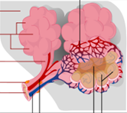
Respiratory System
Inside your lungs, at
the ends of the bronchial
branches, there are millions
of alveoli. These little sacs
are where gas exchange
occurs. Small blood vessels
are delivering oxygen and
removing
carbon dioxide.
Notes:
http://commons.wikimedia.org/wiki/File:Respiratory_system_complete_en.svg
http://commons.wikimedia.org/wiki/File:Respiratory_system.svg

Slide 7
Respiratory System
The diaphragm is a muscular area
that helps the lungs expand and
contract. If you inhale deeply and
feel under your ribs, you can feel the
diaphragm contracting. When you
exhale, you can feel it expanding.
Notes:
http://commons.wikimedia.org/wiki/File:Respiratory_system.svg

Slide 8
Respiratory System
Functions include:
Supplying oxygen we inhale to the blood
Removing carbon dioxide we exhale from the blood
Notes:
http://commons.wikimedia.org/wiki/File:Respiratory_system.svg

