Slide 1
Integumentary System

Slide 2
Integumentary System
Composed of skin, hair, sweat glands, and nails
The name is derived from the Latin integumentum, which means “a covering.”
The skin, considered the largest human organ, covers the body.
The hair covers the head and other parts of the body.
The nails cover the tops of the fingers and toes.
Notes:
http://upload.wikimedia.org/wikipedia/commons/5/5d/Anatomy_The_Skin_-_NCI_Visuals_Online.jpg

Slide 3
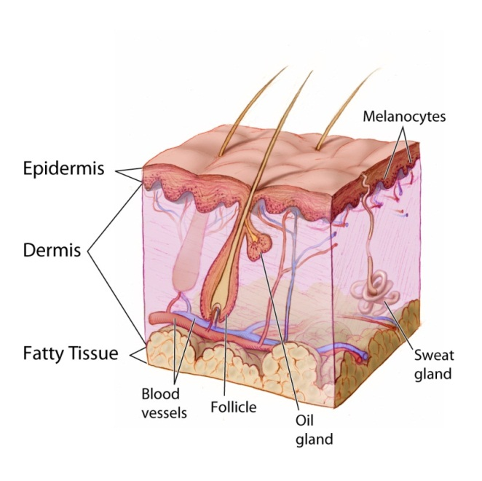
Integumentary System
Functions include:
Protects the body’s internal tissues and organs
Protects against infectious organisms and injury
Prevents loss of body fluids
Notes:
http://upload.wikimedia.org/wikipedia/commons/5/5d/Anatomy_The_Skin_-_NCI_Visuals_Online.jpg

Slide 4
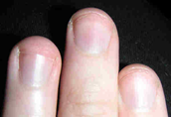
Integumentary System
Functions include:
Regulates body temperature through sweat and regulating peripheral blood flow
Removes waste from the body through perspiration
Generates vitamin D through exposure to UV light
Notes:
http://commons.wikimedia.org/wiki/File:Fingernails.jpg

Slide 5
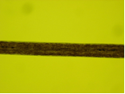
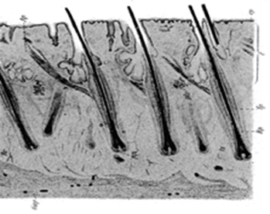
Integumentary System
Functions include:
Protects against sunburns from UV rays
Stores fat for fuel and insulation
Sensory organ with receptors for touch, pressure, pain, heat, and cold
Notes:
http://commons.wikimedia.org/wiki/File:Human_Hair_10x.JPG
http://commons.wikimedia.org/wiki/File:PSM_V71_D115_Cross_section_of_human_skin_displaying_hair_follicles.png

Slide 6
Integumentary System
Hair is composed of strong, dead protein called keratin.
This same protein makes up the nails and outer layer of skin.
Most of the keratin people interact with is dead.
The body sheds the old cells as new cells push up from underneath.
Notes:
http://commons.wikimedia.org/wiki/File:Human_Hair_10x.JPG
http://commons.wikimedia.org/wiki/File:PSM_V71_D115_Cross_section_of_human_skin_displaying_hair_follicles.png

