Slide 1
Endocrine System

Slide 2
Endocrine System
The endocrine system is composed of glands that release hormones into the bloodstream to control body functions such as growth, reproduction, and metabolism.

Slide 3
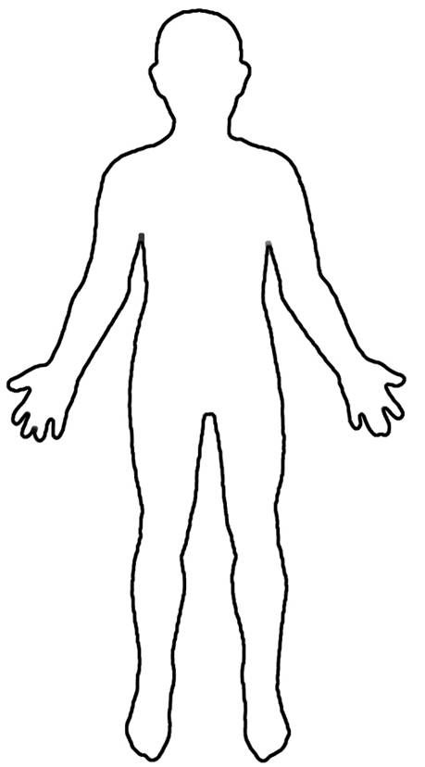
Where are the glands?
Notes:
http://en.wikipedia.org/wiki/File:Outline-body.png

Slide 4
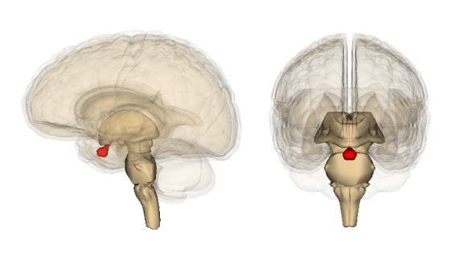
Pituitary
Pituitary
The pituitary gland produces a growth hormone which controls growth and homeostasis.
Notes:
http://commons.wikimedia.org/wiki/File:Pituitary_gland_image.png
http://en.wikipedia.org/wiki/File:Outline-body.png

Slide 5
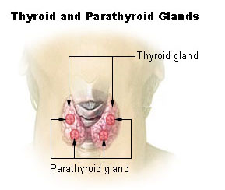
Parathyroid
Parathyroid
The parathyroid gland produces parathormone which controls calcium levels in the body.
Notes:
http://commons.wikimedia.org/wiki/File:Illu_thyroid_parathyroid.jpg
http://en.wikipedia.org/wiki/File:Outline-body.png

Slide 6
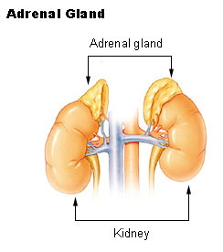
Adrenals
Adrenals
Adrenals
The adrenal glands produce adrenaline in response to physical and emotional stress. Fight or Flight
Notes:
http://commons.wikimedia.org/wiki/File:Illu_adrenal_gland.jpg
http://en.wikipedia.org/wiki/File:Outline-body.png

Slide 7
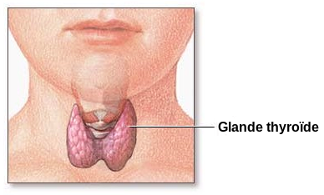
Thyroid
Thyroid
The thyroid gland produces thyroxin to regulate metabolism.
Notes:
http://commons.wikimedia.org/wiki/File:Thyroid_gland-fr.svg
http://en.wikipedia.org/wiki/File:Outline-body.png

Slide 8
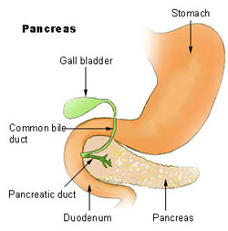
Pancreas
Pancreas
The pancreas produces insulin which controls sugar levels in the blood.
Notes:
http://commons.wikimedia.org/wiki/File:Pancreas_nih.jpg
http://en.wikipedia.org/wiki/File:Outline-body.png

Slide 9
Testes (in males)
Testes
The testes produce testosterone used in sperm production and the development of male traits.
Notes:
http://en.wikipedia.org/wiki/File:Outline-body.png

Slide 10
Ovaries (in Females)
Ovaries
The ovaries produce estrogen used in egg production and the development of female traits.
Notes:
http://en.wikipedia.org/wiki/File:Outline-body.png

